Slide 1

Defining Luxury:
Determining What Factors Give Las Vegas Hotel Guests A Good Time
Peyton Camden
Christopher Barua
Brandon Cook
December 9, 2021
We have neither given or received, nor have we tolerated others’ use of unauthorized aid.
Brandon Cook, Christopher Barua, Peyton Camden

Slide 2
01
03
05
Context
Results
Conclusion
02
04
What we did instead
Discussion & Analysis
T
🠺
🠺
What we were doing, and why it didn’t work
What did our new methodology tell us?
Results, applications of results, and possible improvements
How we changed our methodology to fit our data set
Implications of results

Slide 3
Context
🠺
🠺
Manually cleaned dataset (methodology 1)
Created a dictionary of numeric values for all categorical variables (Monday=1, Tuesday=2, etc.)
Ran backwards elimination to find features with p-value<0.05, 5 features
Dictionary put weight on numeric values (Tuesday worth more than Monday)
Ran different models, but results couldn’t be trusted (high variance)
Confusion matrices showed either no low scores predicted, or scores predicted wrong more often than right
This method abandoned due to incredibly low accuracy/F1 scores in oversampled/weighted data and out of precaution for inaccurate results because of dictionary
Revisit exploratory data analysis and cleaning, and create new methodology (methodology 2)

Slide 4
Hypothesis:
By examining different classification and regression models and comparing their cross validation accuracy and F1 scores, this project will identify the most effective machine learning algorithm and features to predict scores for Las Vegas hotels by TripAdvisor users.

Slide 5
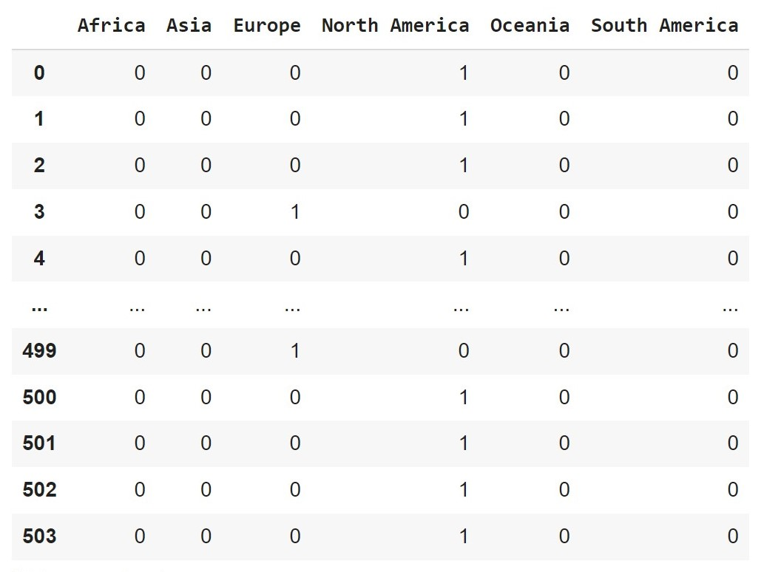
Methodology 2
T
🠺
🠺
Used label binarize function on uncleaned dataset
All columns with categorical variables were binarized (‘Review day’ column is replaced with seven new columns, ‘Monday’, ‘Tuesday’, etc.)
Resulted in 116 columns, instead of 20
Compared unweighted, oversampled, and weighted data model CV score & F1 score to decide how to balance data
Limited models to decision trees, random forest, linear regression models for best balance of data

Slide 6
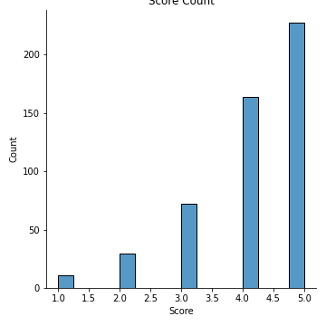
Score Distribution
Overall, the data was very imbalanced, so no modelling could be done without determining if the data could be balanced out somehow without decreasing error too much.

Slide 7
Results
T
1
🠺
🠺

Slide 8
Results
Oversampled and weighted data predicted lower hotel scores, whereas imbalanced data did not predict scores of 1 or 2 at all
Imbalanced and weighted CV scores were similar enough the difference was negligible (0.481 and 0.491) and both were determined to be fair methods to balance data
T
3
🠺
🠺
The best features to predict hotel score via backwards elimination are:
‘Dummy Pool’
‘Dummy Free Internet’
‘Saturday’
‘China’
‘Business’
‘Excalibur Hotel and Casino’
Random Forest classification model had the highest CV scores of all models tested.

Slide 9
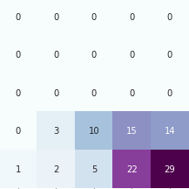
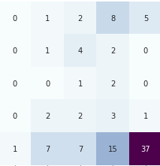
Results
T
4
🠺
🠺
1 2 3 4 5
1 2 3 4 5
Predicted Label
Predicted Label
1 2 3 4 5
1 2 3 4 5
True Label
True Label
Imbalanced Data
Weighted Data

Slide 10
Result Values
Imbalanced Data
Oversampled Data
Weighted Data
T
5
🠺
🠺
Decision Tree:
CV Accuracy Score- 0.503
CV F1 Score- 0.25
MAE- 0.729
Decision Tree:
CV Accuracy Score- 0.397
CV F1 Score- 0.399
MAE- 1.517
Decision Tree:
CV Accuracy Score- 0.481
CV F1 Score- 0.409
MAE- 0.729
Random Forest:
CV Accuracy Score- 0.491
CV F1 Score- 0.399
MAE-0.746
Random Forest:
CV Accuracy Score- 0.404
CV F1 Score- 0.335
MAE- 1.472
Random Forest:
CV Accuracy Score-0.481
CV F1 Score- 0.412
MAE- 0.893
Linear Regression:
MAE- 0.759
Linear Regression:
MAE- 1.592
Linear Regression:
CV Score- don’t ask

Slide 11
Discussion
🠺
🠺
Best model type depends on intended use
A model like this will help a consumer (hotel) most by accurately predicting lower scores, but that gives low overall accuracy
For our purposes, random forest classification model with original imbalanced data or weighted is best, even though it is not very impressive in accuracy or F1 scores
The dataset is extremely limited and very imbalanced
Accuracy isn’t always the best metric to use with imbalanced data
Among the various models that were tested, it is between the random forest models for the imbalanced data and the weighted data as the best models for the dataset
The difference between their CV Accuracy CV F1, and CV MAE are almost negligible

Slide 12
Conclusions
Applications of Results
Potential Improvements
T
5
🠺
🠺
Being able to predict the lowest review scores will help hotel owners filter constructive criticism from rude everyday grouches, and only apply relevant changes to their business so as not to over allocate resources
More low score data
Larger data set in general
More longevity to data
More complex method to select features
Synthetic data

Slide 13

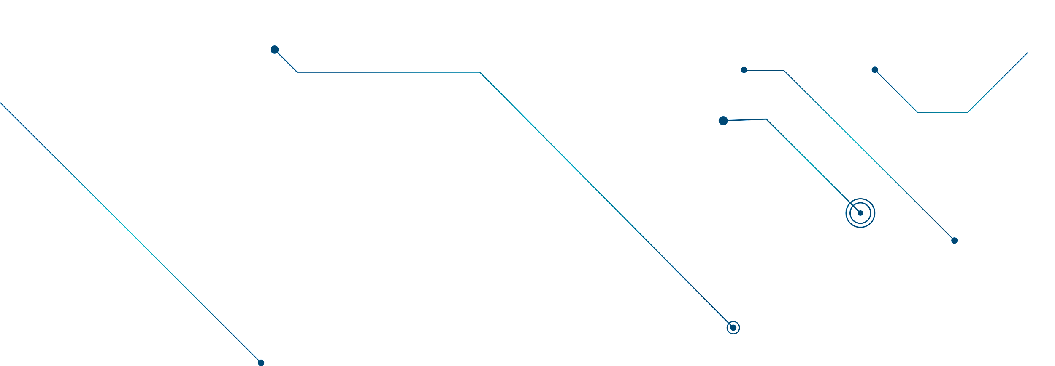
References
🠺
🠺
Chawla, N. V., Bowyer, K. W., Hall, L. O., & Kegelmeyer, W. P. (2002). SMOTE: synthetic minority over-sampling technique. Journal of Artificial Intelligence Research, 16, 321–357.
Harris, C. R., Millman, K. J., van der Walt, S. J., Gommers, R., Virtanen, P., Cournapeau, D., … Oliphant, T. E. (2020). Array programming with NumPy. Nature, 585, 357–362. https://doi.org/10.1038/s41586-020-2649-2.
McKinney, W., & others. (2010). Data structures for statistical computing in python. In Proceedings of the 9th Python in Science Conference (Vol. 445, pp. 51–56).
Pedregosa, F., Varoquaux, Ga"el, Gramfort, A., Michel, V., Thirion, B., Grisel, O., … others. (2011). Scikit-learn: Machine learning in Python. Journal of Machine Learning Research, 12(Oct), 2825–2830.
UCI Machine Learning Repository: Las Vegas Strip Data Set. UCI Machine Learning Repository: Las Vegas Strip data set. (n.d.). Retrieved December 1, 2021, from https://archive.ics.uci.edu/ml/datasets/Las+Vegas+Strip.
Slideshow template from Slidesgo

Slide 14
Demo
https://colab.research.google.com/drive/1JY5d1L8L5Gz4EoFZzg2iXJxhYOqPLxIB

